Slide 1
Exploratory Data Analysis of Large-Scale Retail Transaction Data
Presented by : Sarthak Sandhan
Class : Integrated B.Tech (Computer Science Engineering)
College name : Sanjivani University
Tools & Technologies : Python • Pandas • NumPy • Matplotlib • Seaborn • SciPy
Page 1

Slide 2
Introduction
What is EDA?
Systematic examination of data to summarize main characteristics, detect patterns, and surface anomalies before modeling.
Why EDA matters
Reduces model risk, improves feature selection, and uncovers biases or data quality issues that affect business decisions.
Business objectives
Understand data, discover patterns, detect anomalies, and prepare datasets for Machine Learning.
Page 2

Slide 3
Dataset Overview
Size: 100,000 rows
Columns: 18
Data types: Numerical, Categorical, Date
Example columns: Age, Product Price, Final Price, Product Category, Customer Segment, Payment Method, Shipping Type.
Column
Type
age
Numerical
product_price
Numerical
final_price
Numerical
product_category
Categorical
customer_segment
Categorical
payment_method
Categorical
Page 3

Slide 4
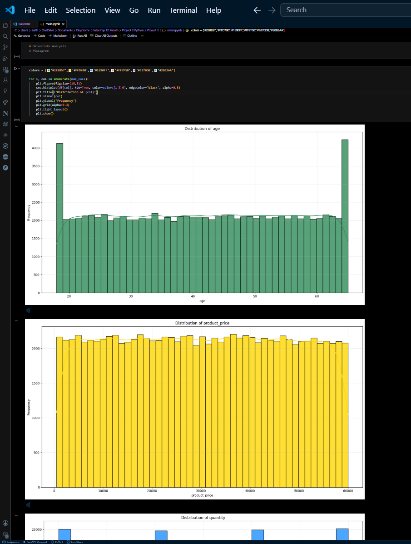
Univariate Analysis
Descriptive statistics
Mean, Median, Std Dev, Min, Max, Skewness, Kurtosis — computed for key numeric fields.
Visuals
Histogram, Boxplot, Countplot used to show distributions and class balances.
Key insights
Product price distribution is right-skewed; extreme final prices exist; regular customers dominate transaction counts.
Page 4

Slide 5
Outlier Detection
Methods applied:
Boxplot visualization
IQR method (Q1 - 1.5*IQR, Q3 + 1.5*IQR)
Z-score thresholding for extreme values
Observations:
High-value premium purchases and bulk orders identified
Delivery time extremes linked to rural shipments and exceptions
Decision: Outliers retained — represent valid, high-value business events
Page 5

Slide 6
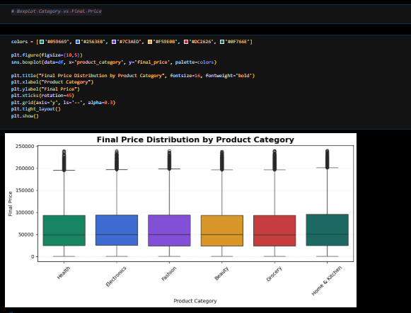
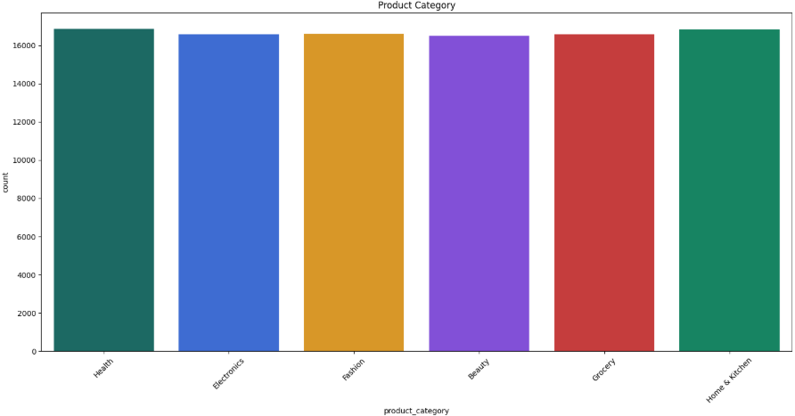
Bivariate Analysis
Relationships examined:
Product Price vs Final Price (price effects)
Quantity vs Final Price (volume impact)
Customer Segment vs Spending (behavioral differences)
Shipping Type vs Delivery Days (logistics)
Boxplot Category vs Final Price
Segment Spending
Final prices vary across product categories, with all categories exhibiting a wide range of values and several high-price outliers.
Premium segment leads average spend.
Business insights:
Premium customers spend more per transaction
Express shipping significantly reduces delivery time
Page 6

Slide 7
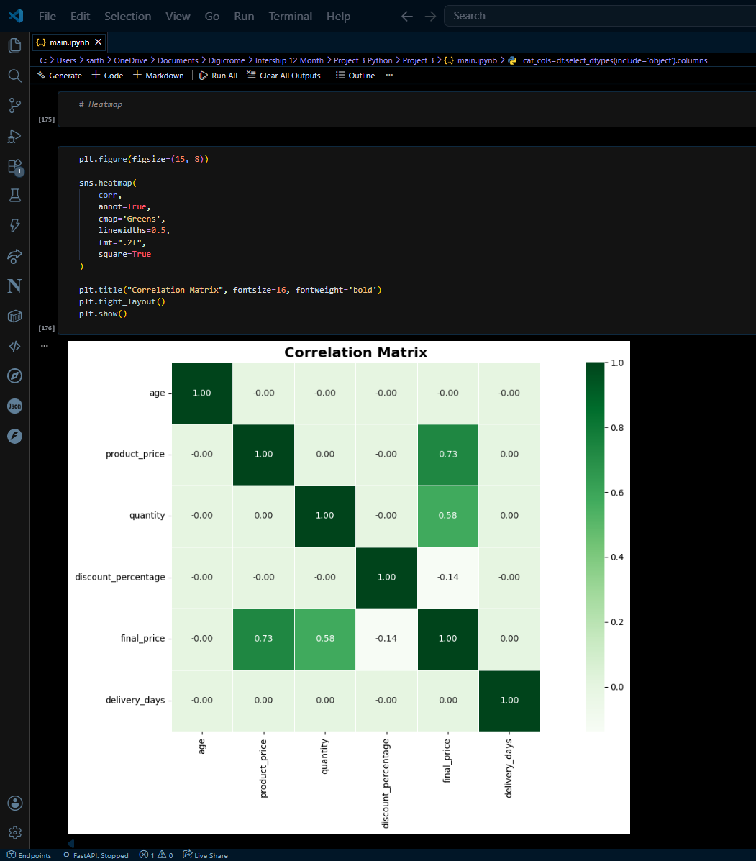
Correlation Analysis
Method: Pearson correlation on numeric features with heatmap visualization.
Strong positive
Product Price ↔ Final Price; Quantity ↔ Final Price
Negative
Discount Percentage ↔ Revenue (higher discounts reduce per-transaction revenue)
Multicollinearity
No problematic multicollinearity detected — safe for most modeling approaches.

Slide 8
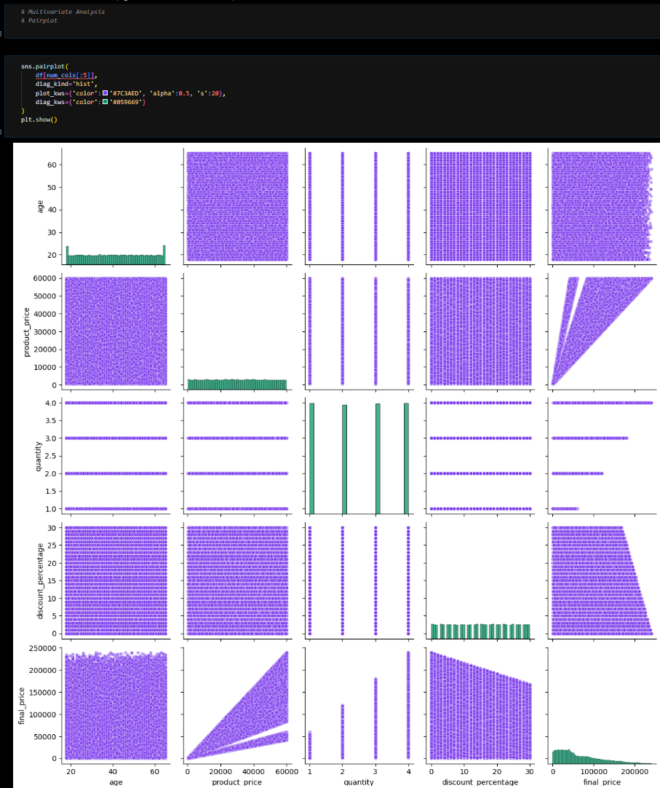
Multivariate Analysis
Explored interactions across three or more variables to reveal conditional patterns:
Product Category × Discount × Final Price — Electronics show steep revenue gains with moderate discounts.
Customer Segment × Age × Spending — Premium customers aged 30–45 have highest Spend.
Delivery Days × Shipping Type × Return Status — Longer delivery correlates with increased return probability.
Visuals: Heatmap and pairplot used to surface interaction effects.
Page 8

Slide 9
Business Insights
Revenue shape
Customer value
Discount strategy
Revenue distribution is right-skewed — a small number of high-value orders drive large share of revenue.
Premium customers contribute disproportionately to revenue; prioritize retention and targeted offers.
Moderate discounts increase volume without overly eroding revenue; deep discounts reduce margin.
Logistics impact
Category focus
Longer delivery times increase return probability — optimize shipping mix to reduce returns.
Electronics drives highest revenue — consider inventory and promotion prioritization.
Page 9

Slide 10
Conclusion & Next Steps
Completed
Future scope
Predictive modeling (sales forecasting).
Customer segmentation and CLV modeling.
Recommendation systems and personalized promotions.
Univariate, Bivariate, Multivariate analyses
Correlation and Outlier detection
Visualizations and business-level interpretations
Libraries used: Pandas, NumPy, Matplotlib, Seaborn, SciPy Stats, Warnings.
Thank You Questions & Discussion
Page 10

